Slide 1
What are the Symptoms?

Slide 2
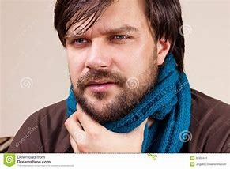

Slide 3
